Slide 1
PrintNet T Triple Suite
Data Output

Slide 2
Introduction
Workflow
&
Document
Design
Approval
(Proof)
Spool Production
Output
Data
Output

Slide 3
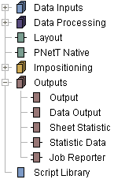
Outputs usage
Output, Data Output and Sheet Statistic
    They terminate your workflow if Impositioning or through-flow output module is used.
    When no Impositioning or through-flow output module is used, also Layout and PNetTNative modules can terminate a workflow.
Notes:
Output, Data Output and Sheet Statistic
They terminate your workflow if Impositioning or through-flow output module is used.
When no Impositioning or through-flow output module is used, also Layout and PNetTNative modules can terminate a workflow.

Slide 4
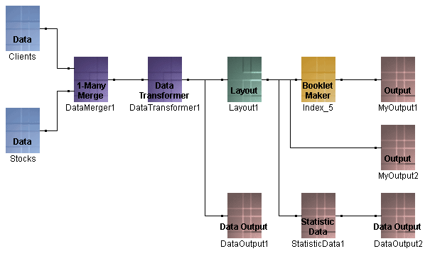
Data Output Purpose
Data manipulation
Modification
Another data file
    CSV
    Flat
    XML
    TSD
    PureFlat
    Null
Notes:
Workflow or its parts can be used for data manipulation and modification only. It results not in printed sheets but in another data file.
Possibilities
CSV – comma separated value
Flat – comma separated with quotes
XML
TSD – internal format, optimization
PureFlat – comma separated but no quotes
Null – Just for time measurements, just generates not records…

Slide 5
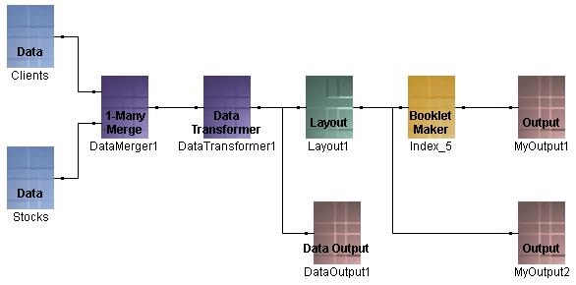
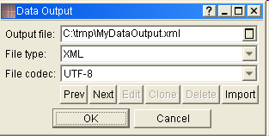
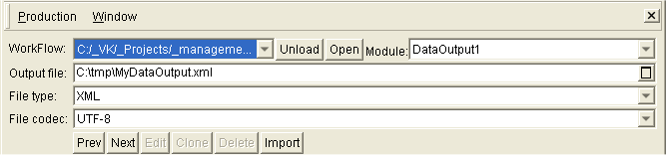
Data Output Set-up
Notes:
Data Output module can be placed behind modules from section Data Inputs, Data Processing or flow through Outputs.
Data Output properties can be modified as in Workflow as in Production environment.

Slide 6

Any Questions? Thank you.

